Slide 1

Food Recommender

Slide 2





Chief Executive Officer
Chief Technology Officer
Chief Finance Officer
Kang Seong Soo
Ray
Yeo In Jun
Jun
Choi Jae Won
Tommy
Chief Data Officer
Chief Marketing Officer
Heo Sun Hwa
Sarah
Pae Han sol
David

Slide 3


Problem
Customer:
Restaurant:
What do you want to eat?
What do customers actually want?
Up to you
?
Anything
?

Slide 4
Do they actually agree to our problems?
Customer
Restaurant
Do you have difficulty searching for restaurants? (204 responses)
No POS provides customer centric data
Expensive consultation service

Slide 5



Our solution
Customer
Food Recommender App
Restaurant
POS App
“Using Machine Learning”

Slide 6
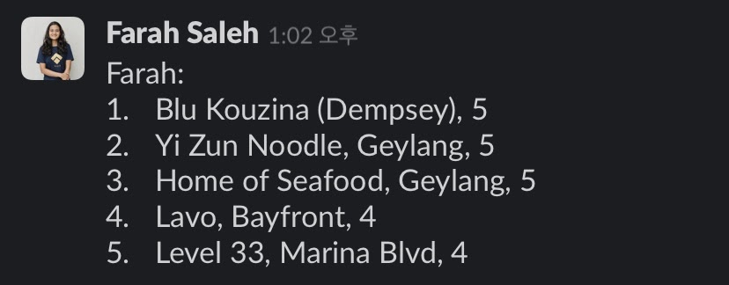
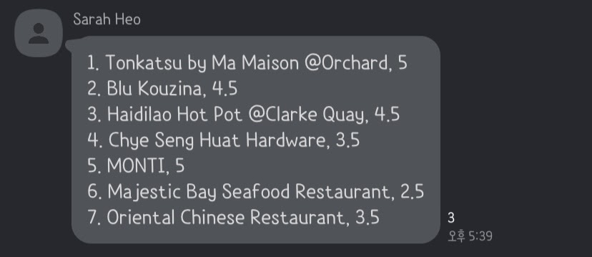
Customer Data
Restaurant Data

Slide 7
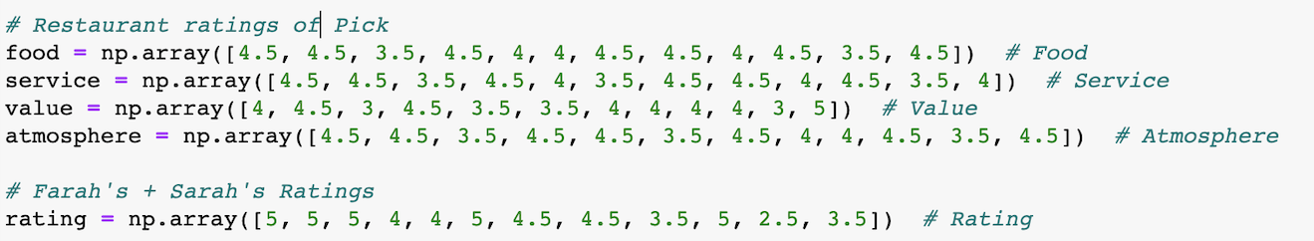
4.5
4.5
4
4.5

Slide 8



Slide 9
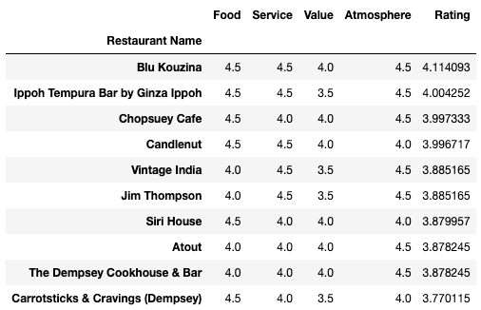
Top Restaurant listing located in Dempsey Hill and East Coast

Slide 10
FRED App
FRED POS
Order / pay
Payment
Transaction
Kitchen order
Review
Preferences
Analytics
Feedback
Prediction sales

Slide 11
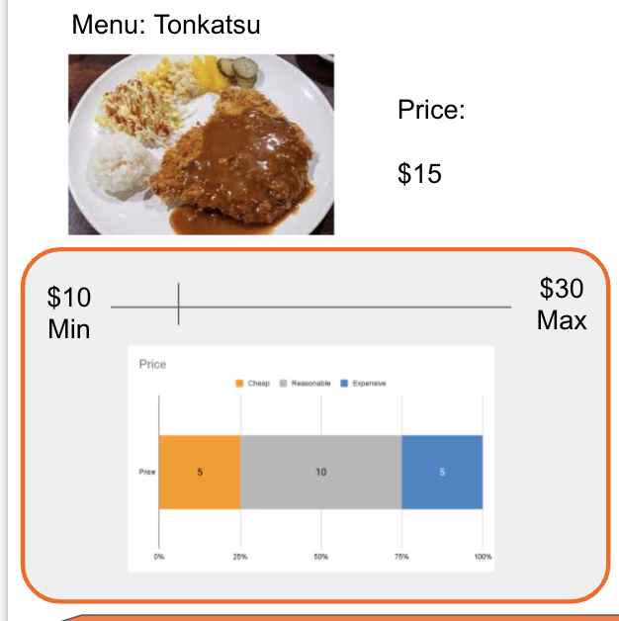
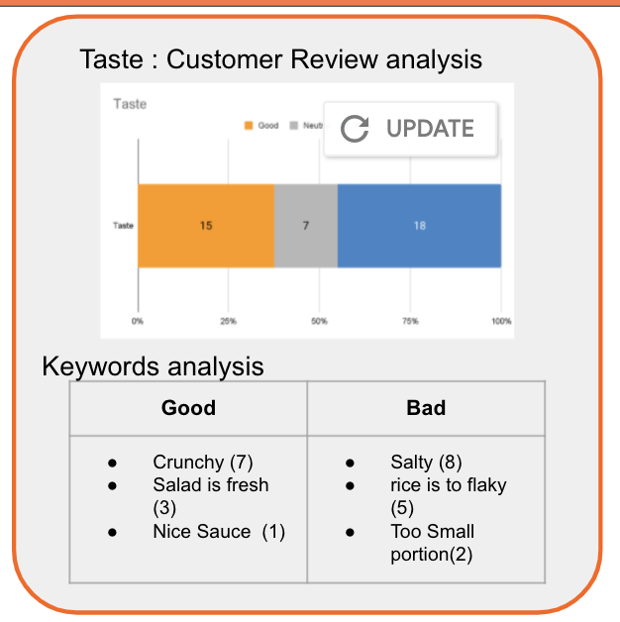
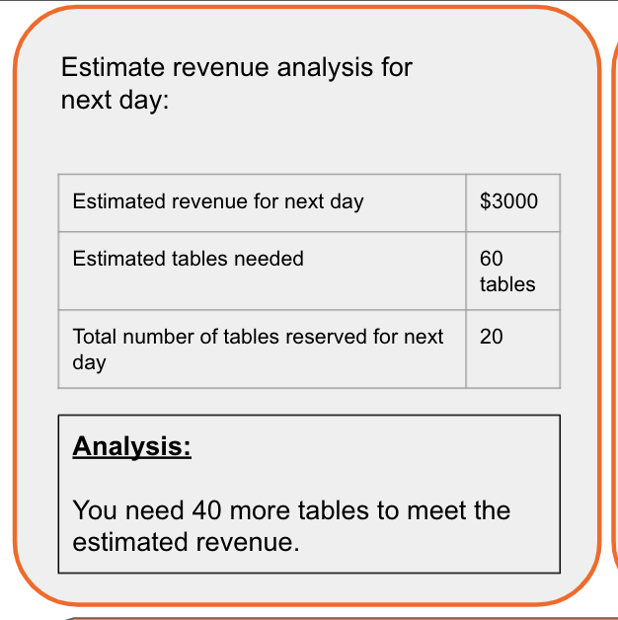
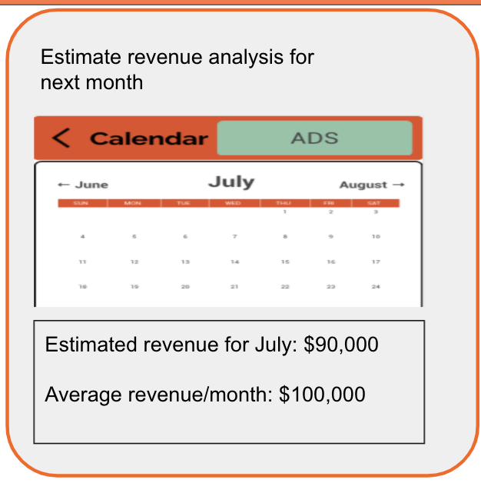

Slide 12
Our analytics data can be further categorised into?
District
Country
Region
Globe

Slide 13
Why FRED?

Slide 14
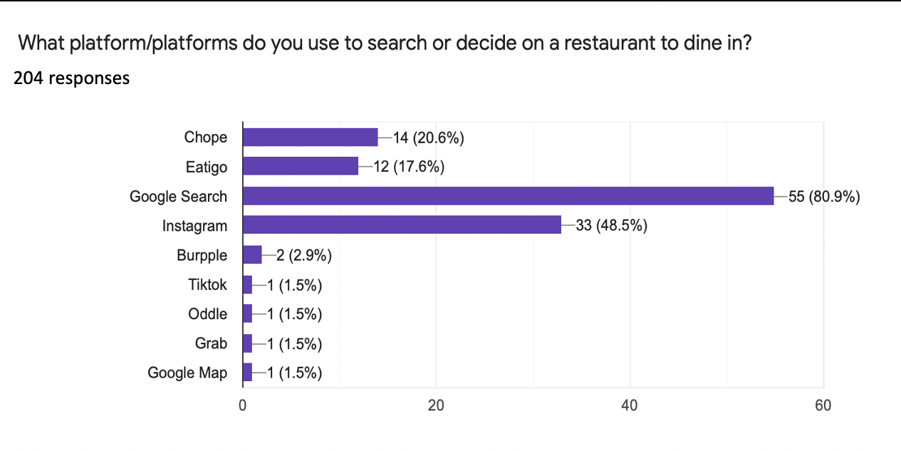
Differentiation
The only app to recommend a restaurant to a group
The only app to use Machine learning based on preference
Free to use
Complete process
Searching -> ordering -> payment

Slide 15


Differentiation (POS)
 | POS | FRED POS
Attracts customer
Analytics | Business Centric | Business & Customer Centric
Acquisition Cost
Maintenance Cost
POS Hardware (monitor etc)
Restaurants to street vendors

Slide 16
Our Plan

Slide 17
Total number of restaurants (2019) : 12,260
(not inclusive of fast-food outlets)
Revenue
FRED Advertisement
FRED POS Free Service
Revenue
FRED Advertisement
FRED POS Commission per transaction
1st Year
2022
2nd Year
2023
3rd Year
2024
4th Year
2025
5th Year
2026
Product
Development
Beta Testing
In Singapore
Official Launch
In Singapore
Expansion Plan
1. New Service
Delivery and Consultation
2. Venture
Malaysia, Indonesia, Thailand
FRED
number of users: 25,000
Listed restaurants: 310
FRED POS
number of restaurants: 50
FRED
number of users: 350,000
Listed restaurants: 2,410
FRED POS
number of restaurants: 600
FRED
number of users: 700,000
Listed restaurants: 6,900
FRED POS
number of restaurants: 1,200 (10%)
“Listed restaurants in FRED App will only include from FRED POS registered restaurants”

Slide 18
Revenue Model
Advertisement
Commission
10%
per transaction

Slide 19
Published in 2020
Revenue Calculation Method
Market Share x Commission x Market Size
10% 10%
Total Revenue : $342 million
(10%)
(10%)
(10%)
(10%)
Compound Annual Growth Rate

Slide 20
Game Changer
Ability to eliminate food service platforms
– Delivery and Booking
Free data analytics of the industry
– a new form of consultation

